Slide 1
Supervised Learning
Linear Separability, Regression, SVM
S.V.Jansi Rani
Associate Professor / CSE
UCS 1603 Introduction to Machine Learning

Slide 2
Agenda
Linear Separability
Regression
SVM

Slide 3







Slide 4
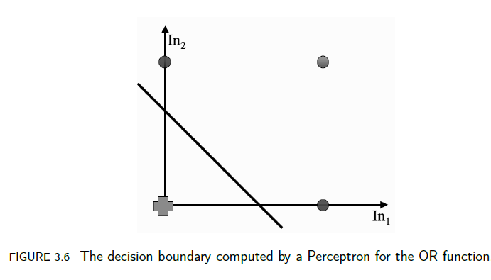
Linear Separability
The Perceptron does tries to find a straight line (in 2D, a plane in 3D, and a hyperplane in higher dimensions) where the neuron fires on one side of the line, and doesn’t on the other. This line is called the decision boundary or discriminant function

Slide 5
Geometry of linear Separability
The equation of a line is
w_0 + w_1*x + w_2*y=0
It also means that point (x,y) is on the line
This equation is equivalent to
w⋅x = (w_0, w_1,w_2) ⋅(1,x,y) = 0
If w⋅x > 0, then the angle
between w and x
is less than 90 degree, which means that
w and x lie on the same side of the line.
w
Each output node of perceptron tries to separate the training data
Into two classes (fire or no-fire) with a linear decision boundary,
i.e., straight line in 2D, plane in 3D, and hyperplane in higher dim.

Slide 6
Consider just one input vector x.
The neuron fires if x·w^{T} >= 0
w^{T} denotes the transpose of w and is used to make both of the vectors into column vectors.
The a · b notation describes the inner or scalar product between two vectors.
a · b = |a||b|cos θ , where θ is the angle between a and b and |a| is the length of the vector a.
So the inner product computes a function of the angle between the two vectors, scaled by their lengths

Slide 7
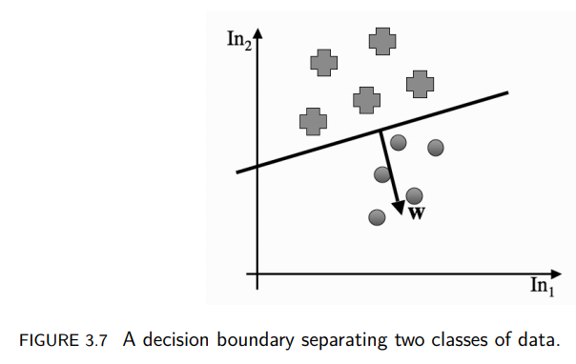

Consider the boundary case, input vector
x₁, ->x₁·w^{T} = 0
x₂, ->x₂·w^{T} = 0
In order for the inner product to be 0, either |a| or |b| or cos θ needs to be zero. θ = π/2 (or −π/2)
x1 − x2 is a straight line between two points that lie on the decision boundary, and the weight vector wT must be perpendicular to that

Slide 8
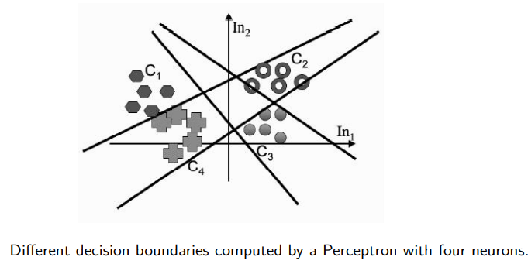
Many output neurons- weights for each neuron separately describe a straight line
Putting together several neurons we get several straight lines that each try to separate different parts of the space

Slide 9
Perceptron Convergence Theorem
Perceptron will converge to a solution that separates the classes, and that it will do it after a finite number of iterations. In fact, the number of iterations is bounded by 1/γ² , where γ is the distance between the separating hyperplane and the closest datapoint to it.

Slide 10
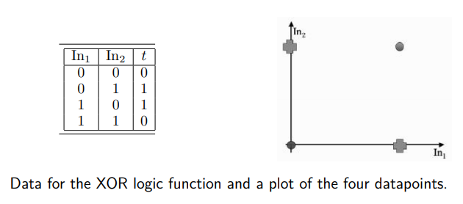
The Exclusive Or (XOR) Function
Not linearly separable

Slide 11
Linear Regression
Regression problems, where we fit a line to data
Classification problems, where we find a line that separates out the classes
For regression we are making a prediction about an unknown value y (such as the indicator variable for classes or a future value of some data) by computing some function of known values x
Output y is going to be a sum of the xi values, each multiplied by a constant parameter:
The β_{i} define a straight line (plane in 3D, hyperplane in higher dimensions) that goes through (or at least near) the datapoints.

Slide 12
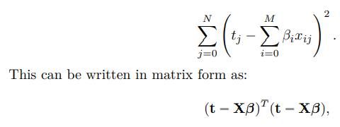
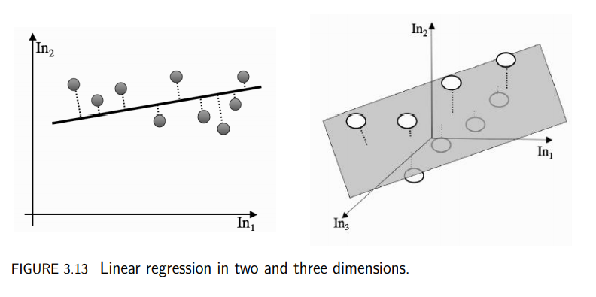
To define the line that best fits the data - common solution is to try to minimise the distance between each datapoint and the line that we fit.
We can measure the distance between a point and a line by defining another line that goes through the point and hits the line.
Least-squares optimisation - to minimise error

Slide 13
Difference….
In Regression, we try to find the best fit line, which can predict the output more accurately. | In Classification, we try to find the decision boundary, which can divide the dataset into different classes.

Slide 14
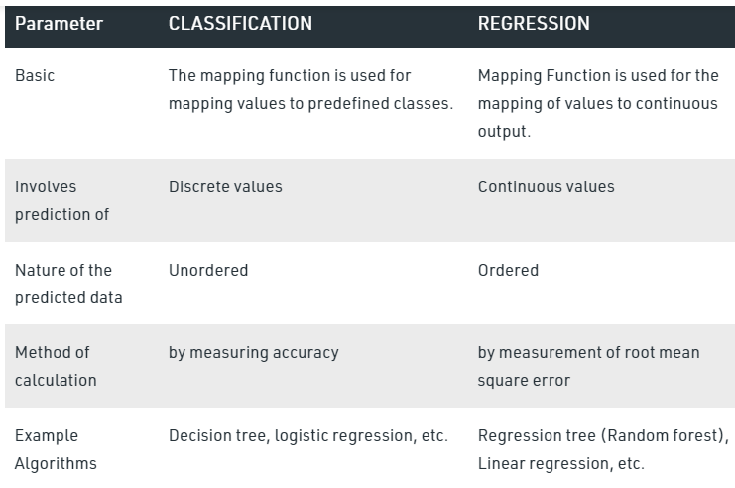

Slide 15
Examples
Regression
The price of a liter of petrol
Age , salary of a person
The price of diamonds
Weather Prediction, House price prediction
Classification
Days of the week
Shirt sizes (small, medium, large)
True or False (and Yes or No) — this is a very special situation
Identification of spam emails, Speech Recognition, Identification of cancer cells

Slide 16
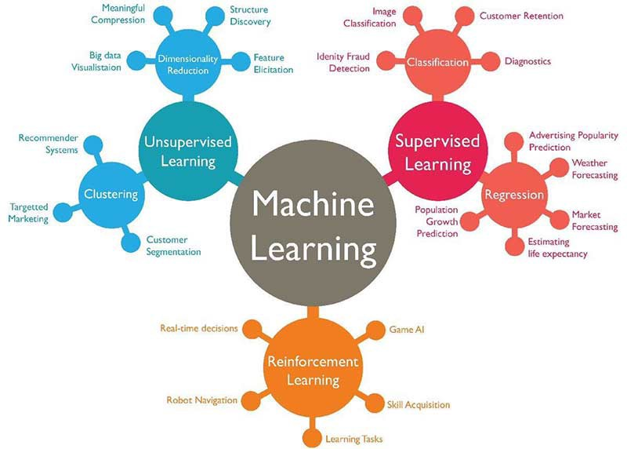

Slide 17
Summary
Linear Separability
Regression
SVM

Slide 18
Check your understanding
Perceptron uses ______________ to fit a line in higher dimension
__________ is not linearly separable
_____________ is used to minimise error in linear regression
Forecasting reveneus and expenditures is an example of ___________ problem

Slide 19
techNews Time
Who is ready today?

Slide 20
THANK YOU
Courtsey : Stephen Marsland

